Slide 1
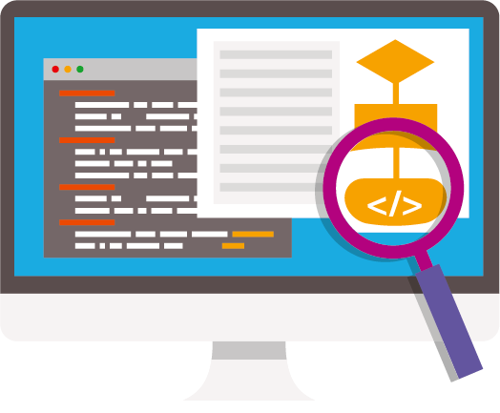
Binary and computer logic
Lesson 3: Creating an app

Slide 2
Objectives
In this lesson, you will:
consolidate your understanding of logic gates or binary
write an algorithm for an app
begin to code your app.

Slide 3
Planning an app (Part 1)
Code an app that will teach students your age or slightly younger about logic gates or the binary system.
The app must be programmed in Scratch.
It can take the form of a game, an animation, a quiz or a combination of all three.
You only have about an hour to code your app so don’t be over ambitious!

Slide 4

Activity 3.1: Planning an app (Part 2)

Slide 5
Activity 3.2: Coding your app
Go to https://scratch.mit.edu/, select ‘Create’ and code the app you have planned in Scratch.
Remember to save your app to your computer at the end of the lesson, by selecting ‘File’ and choosing ‘Save to your computer’.

Slide 6
Quiz 3

